Slide 1

HTML & CSS
By
BJIT Academy
Image Placeholder

Slide 2
What is HTML?
HTML stands for Hyper Text Markup Language
HTML is the standard markup language for creating Web pages
HTML describes the structure of a Web page
HTML consists of a series of elements
HTML elements tell the browser how to display the content
HTML elements label pieces of content such as "this is a heading", "this is a paragraph", "this is a link", etc.

Slide 3
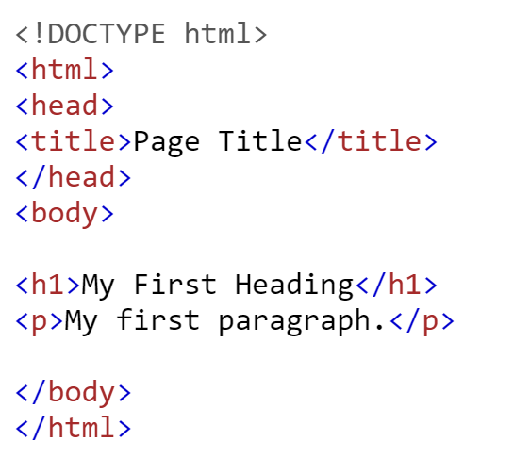
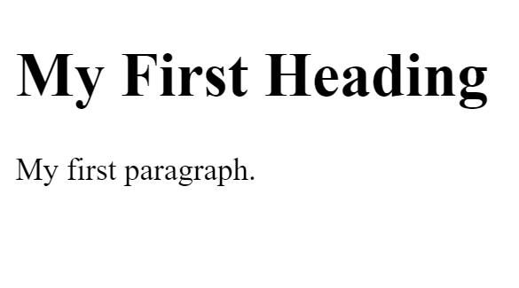
What is HTML?
Output

Slide 4
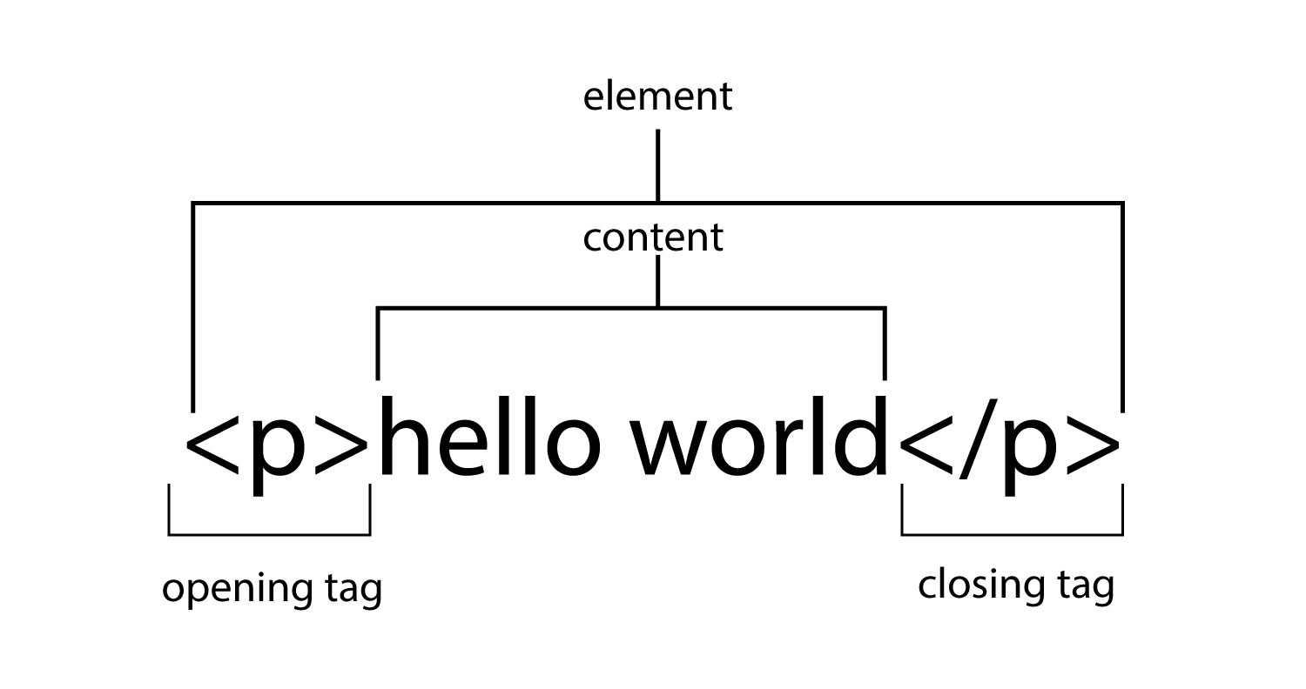
What is an HTML Element?
An HTML element is defined by a start tag, some content, and an end tag:
<tagname> Content goes here... </tagname>
The HTML element is everything from the start tag to the end tag:
<h1>My First Heading</h1>
<p>My first paragraph.</p>

Slide 5
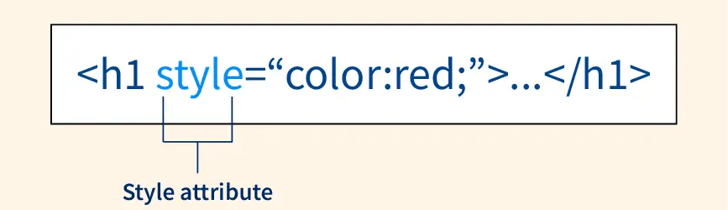
The HTML Style Attribute
Setting the style of an HTML element, can be done with the style attribute.
The HTML style attribute has the following syntax:
<tagname style="property:value;">

Slide 6
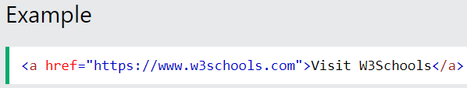
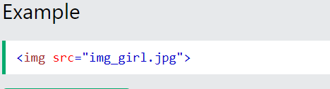
The HTML Style Attribute
All HTML elements can have attributes
Attributes provide additional information about elements
Attributes are always specified in the start tag
Attributes usually come in name/value pairs like: name="value"
The href Attribute
The src Attribute
The <a> tag defines a hyperlink. The href attribute specifies the URL of the page the link goes to:
The <img> tag is used to embed an image in an HTML page. The src attribute specifies the path to the image to be displayed:

Slide 7
HTML Headings
HTML headings are defined with the <h1> to <h6> tags.
<h1> defines the most important heading. <h6> defines the least important heading.
Example
<h1>Heading 1</h1>
<h2>Heading 2</h2>
<h3>Heading 3</h3>
<h4>Heading 4</h4>
<h5>Heading 5</h5>
<h6>Heading 6</h6>

Slide 8
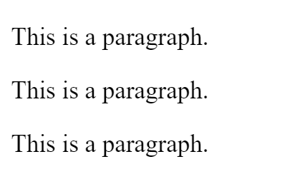
HTML Paragraphs
The HTML <p> element defines a paragraph.
A paragraph always starts on a new line, and browsers automatically add some white space (a margin) before and after a paragraph.
Output
Example
<p>This is a paragraph.</p>
<p>This is a paragraph.</p>
<p>This is a paragraph.</p>

Slide 9
HTML Images Syntax
The HTML <img> tag is used to embed an image in a web page.
Images are not technically inserted into a web page; images are linked to web pages. The <img> tag creates a holding space for the referenced image.
The <img> tag is empty, it contains attributes only, and does not have a closing tag.
The <img> tag has two required attributes:
src - Specifies the path to the image
alt - Specifies an alternate text for the image
Syntax
<img src="url" alt="alternatetext">

Slide 10
HTML Iframe Syntax
The HTML <iframe> tag specifies an inline frame.
An inline frame is used to embed another document within the current HTML document.
Syntax
<iframe src="url" title="description"></iframe>

Slide 11
The HTML <video> Element
To show a video in HTML, use the <video> element:
Example
<video width="320" height="240" controls>
<source src="movie.mp4" type="video/mp4">
<source src="movie.ogg" type="video/ogg">
Your browser does not support the video tag.
</video>

Slide 12
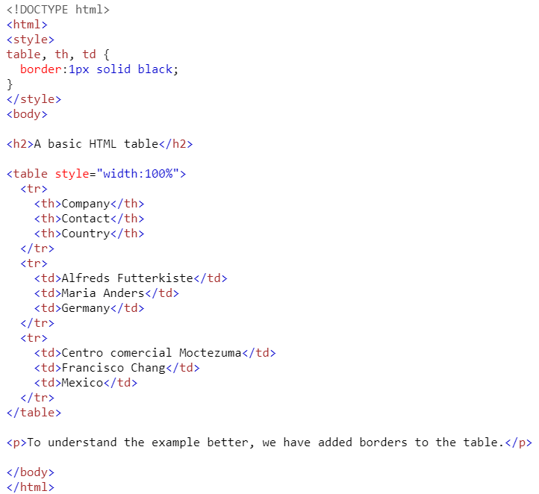
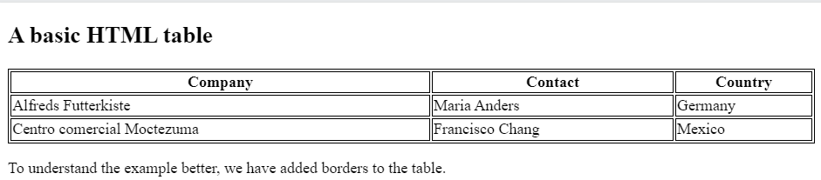
HTML Table
Define an HTML Table
A table in HTML consists of table cells inside rows and columns.
Output

Slide 13

What is CSS?
Cascading Style Sheets (CSS) is used to format the layout of a webpage.
With CSS, you can control the color, font, the size of text, the spacing between elements, how elements are positioned and laid out, what background images or background colors are to be used, different displays for different devices and screen sizes, and much more!

Slide 14
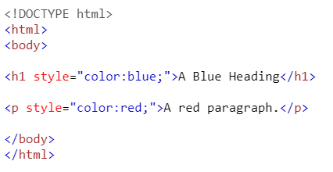
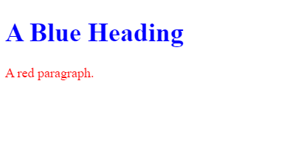
Inline, Internal, External styling
Inline css
An inline CSS is used to apply a unique style to a single HTML element.
An inline CSS uses the style attribute of an HTML element.
The following example sets the text color of the <h1> element to blue, and the text color of the <p> element to red.
Output

Slide 15
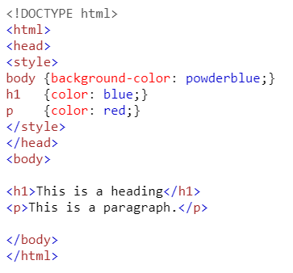
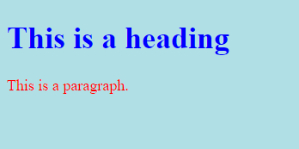
Inline, Internal, External styling
Internal CSS
An internal CSS is used to define a style for a single HTML page.
An internal CSS is defined in the <head> section of an HTML page, within a <style> element.
The following example sets the text color of ALL the <h1> elements (on that page) to blue, and the text color of ALL the <p> elements to red.
In addition, the page will be displayed with a "powderblue" background color.
Output

Slide 16
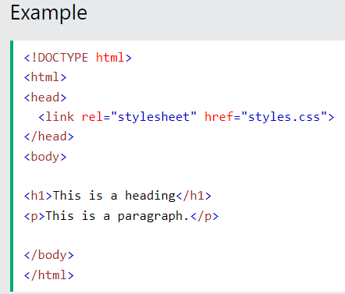
Inline, Internal, External styling
External CSS
An external style sheet is used to define the style for many HTML pages.
To use an external style sheet, add a link to it in the <head> section of each HTML page:

Slide 17
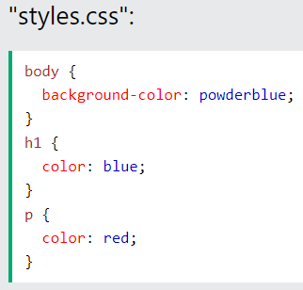
Inline, Internal, External styling
External CSS
The external style sheet can be written in any text editor. The file must not contain any HTML code and must be saved with a .css extension.
Here is what the "styles.css" file looks like:

Slide 18

CSS display Property
The display property specifies the display behavior (the type of rendering box) of an element.
In HTML, the default display property value is taken from the HTML specifications or from the browser/user default style sheet. The default value in XML is inline, including SVG elements.

Slide 19
Thank You
Image Placeholder

